Slide 1
IT5302 SOFTWARE ENGINEERING

Slide 2
The Design Process
Software design is an iterative process through which requirements are translated into a ‘blueprint’ for constructing a software.
The design is represented at a high level of abstraction- a level that can be directly traced to the specific system objective and more detailed data, functional and behavioral requirements.
As design iterations occur, subsequent refinement leads to design representations at much lower levels of abstraction.

Slide 3
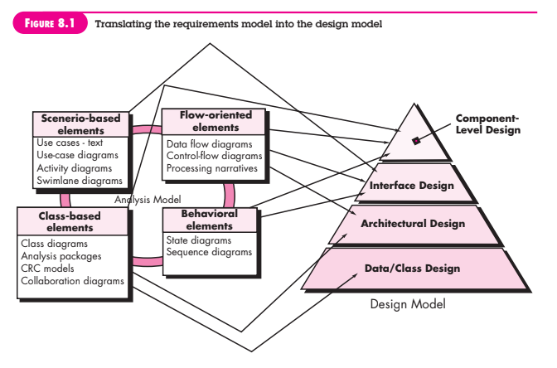

Slide 4
Software Quality Guidelines and Attributes
The design must implement all of the explicit requirements contained in the requirements model and it must accommodate all of the implicit requirements desired by stakeholders.
The design must be a readable, understandable guide for those who generate code and for those who test and subsequently support the software.
The design should provide a complete picture of the software, addressing the data, functional and behavioral domains from an implementation perspective.

Slide 5
Quality Guidelines
A design should exhibit an architecture that
  Has been created using recognizable architectural styles or patterns
  Is composed of components that exhibit good design characteristics
  Can be implemented in an evolutionary fashion, thereby facilitating implementation and testing
A design should be modular, that is the, software should be logically partitioned into elements or subsystems.
A design should contain distinct representations of data, architecture, interfaces and components.

Slide 6
A design should lead to data structures that are appropriate for the classes to be implemented and are drawn from recognizable data patterns.
A design should lead to components that exhibit independent functional characteristics.
A design should lead to interfaces that reduce the complexity of connections between components and with the external environment.
A design should be derived using a repeatable method that is driven by information obtained during software requirements analysis.
A design should be represented using a notation that effectively communicates its meaning.

Slide 7
Quality attributes (FURPS)
Functionality
Usability
Reliability
Performance
Supportability

Slide 8
Design Concepts
A set of fundamental software design concepts has evolved over the history of software engineering
The degree of interest in each concept has varied over the years, each has stood the test of time.
Each provides the software designer with a foundation from which more sophisticated design methods can be applied.
  What criteria can be used to partition software into individual components?
  How is function or data structure detail separated from a conceptual representation of the software?
  What uniform criteria define the technical quality of a software design?

Slide 9
Abstraction
At the highest level of abstraction, a solution is stated in broad terms using the language of the problem environment.
At lower levels of abstraction, a more detailed description of the solution is provided.
A procedural abstraction refers to a sequence of instructions that have a specific and limited function.
A data abstraction is a named collection of data that describes a data object.

Slide 10
Example:
Procedural abstraction would be the word open for a door.
Open implies a long sequence of procedural steps (walk to the door, reach out and grasp knob, turn knob and pull door, step away from moving door etc)
In the context of Procedural abstraction open, we can define a data abstraction called door.
The data abstraction for door would encompass a set of attributes that describe the door (eg. Door type, swing direction, opening mechanism, weight, dimensions)

Slide 11
Architecture
Software architecture alludes to “the overall structure of the software and the ways in which that structure provides conceptual integrity for a system”
In simplest form, architecture is the structure or organization of program components, the manner in which these components interact and the structure of data that are used by the components.
A set of architectural patterns enables a software engineer to solve common design problems.

Slide 12
Set or properties that should be specified as part of an architectural design:
  Structural properties
  Extra-functional properties
  Families of related systems
The architectural design can be represented using one or more of a number of different models:
  Structural models
  Framework models
  Dynamic models
  Process models
  Functional models

Slide 13
Patterns
Brad Appleton defines “a pattern is a named nugget of insight which conveys the essence of a proven solution to a recurring problem within a certain amidst competing concerns”.
A design pattern describes a design structure that solves a particular design problem within a specific context and amid ‘forces’ that may have an impact on the manner in which the pattern is applied and used.
The intent of design pattern is to provide a description that enables a designer to determine
  Whether the pattern is applicable to the current work
  Whether the pattern can be reused
  Whether the pattern can serve as a guide for developing a similar, but functionally or structurally different pattern.

Slide 14
Separation of concerns
Separation of concerns is a design concept that suggests that any complex problem can be more easily handled if it is subdivided into pieces that can each be solved and/or optimized independently.
A concern is a feature or behavior that is specified as part of the requirements model for the software.
By separating concerns into smaller, and therefore more manageable pieces, a problem takes less effort and time to solve.
Separation of concerns is manifested in other related design concepts: Modularity, aspects, functional independence and refinement.

Slide 15
Modularity
Modularity is the most common manifestation of separation of concerns.
Software is divided into separately named and addressable components, sometimes called modules, that are integrated to satisfy problem requirements.
Modularity is the single attribute of software that allows a program to be intellectually manageable.

Slide 16
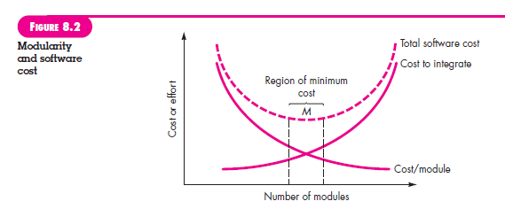

Slide 17
Information hiding
The principle of information hiding suggests that modules be “characterized by design decisions that (each) hides from all others”
The use of information hiding as a design criterion for modular systems provides the greatest benefits when modifications are required during testing and later during software maintenance.
Because most data and procedural detail are hidden from other parts of the software, inadvertent errors introduced during modification are less likely to propagate to other locations within the software.

Slide 18
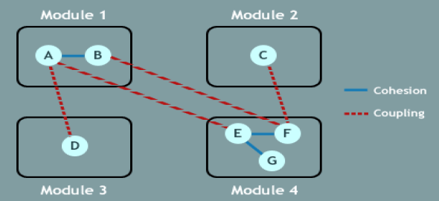
Functional independence
The concept of functional independence is a direct outgrowth of separation of concerns, modularity and the concepts of abstraction and information hiding.
Functional independence is achieved by developing modules with “single minded” function and an “aversion” to excessive interaction with other modules.
Independence is assessed using two qualitative criteria: cohesion and coupling.

Slide 19
Cohesion
  Cohesion is an indication of the relative functional strength of a module.
  Cohesion is a natural extension of the information-hiding concept.
  A cohesive module performs a single-task, requiring little interaction with other components in other parts of a program.
Coupling
  Coupling is an indication of the relative interdependence among modules.
  Coupling is an indication of interconnection among modules in a software structure.
  Coupling depends on the interface complexity between modules, the point at which entry or reference is made to a module and what data pass across the interface

Slide 20
Refinement
Stepwise refinement is a top-down design strategy originally proposed by Niklaus Wirth.
A hierarchy is developed by decomposing a macroscopic statement of function in a stepwise fashion until programming language statements are reached.
Refinement is actually a process of elaboration. Abstraction and refinement are complementary concepts.
Abstraction enables you to specify procedure and data internally but suppress the need for “outsiders” to have knowledge of low-level details.
Refinement helps you to reveal low-level details as design progresses.
Both concepts allow you to create a complete design model as the design evolves.

Slide 21
Aspects
As requirements analysis occurs, a set of “concerns” is uncovered. These concerns “include requirements, use cases, features, data structures, quality-of-service issues, variants, intellectual property boundaries, collaborations, patterns and contracts”
An aspect is a representation of a crosscutting concern.
A crosscutting concern is some characteristic of the system that applies across many different requirements.
It important to identify aspects so that the design can properly accommodate them as refinement and modularization occur.
An aspect is implemented as a separate module rather than as software fragments that are “scattered” or “tangled” throughout many components.
The design architecture should support a mechanism for defining an aspect- a module that enables the concern to be implemented across all other concerns that it crosscuts.

Slide 22
Refactoring
Refactoring is a reorganization technique that simplifies the design or code of a component without changing its function or behavior.
Fowler defines “Refactoring is the process of changing a software system in such a way that it does not alter the external behavior of the code yet improves its internal structure”.
When software is refactored, the existing design is examined for redundancy, unused design elements, inefficient or unnecessary algorithms, poorly constructed or inappropriate data structures or any other design failure that can be corrected to yield a better design.

Slide 23
Object oriented design concepts
The object oriented paradigm is widely used in modern software engineering.
OO design concepts such as classes and objects, inheritance, messages and polymorphism, among others.

Slide 24
Design classes
User interface classes
Business domain classes
Process classes
Persistent classes
System classes
Four characteristics of a well-formed design class:
  Complete and sufficient
  Primitiveness
  High cohesion
  Low coupling

